Slide 1
Mini-Project
- Pose Estimation & Hand Tracking

Slide 2
Literature Survey
IEEE Reference
- https://scihub.hkvisa.net/10.1109/ICVRIS.2018.00014

Slide 3
Abstract
In order to study artificial intelligence-based computer vision
imaging, computer technology was used to efficiently and accurately obtain relevant
information from environmental images or videos. Things and phenomena in the objective
world were analyzed, judged, and decided. Based on biological vision and physical models,
the basic methods and approaches of computer vision were explored. The contents of
evolutionary calculations, pattern recognition, biological vision, and surface defects
detection of slabs were studied. A computer vision system with high adaptability, high
accuracy, and rapid response was developed. The results showed that the evolutionary
calculation methods were diverse in form and versatile. Therefore, it can be applied in
many aspects of computer vision, and its performance is very good.
Keywords - Artificial intelligence; Computer-Vision;
Imaging.

Slide 4
Problem Statement
Pose estimation and Hand-Tracking for objects and Humans is a major trend in computer vision.
Pose estimation allows gaining a more detailed understanding of objects compared to two-dimensional bounding boxes.
Until now, pose estimation is still computationally very intensive and requires expensive AI hardware that is not practical for real-world use.

Slide 5
Existing Sytems
Use Cases and Applications of Pose Estimation and Hand Tracking AS WELL ! :
It has been utilized in a wide range of applications, including Human-Computer interaction, Action Recognition, Motion Analysis, Augmented reality , and Robotics.
Pose estimation and Hand Tracking has applications in lots of fields, some of which are listed below. Most Popular Applications Application
#1: Human Activity Estimation Application
#2: Motion Transfer and Augmented Reality Application
#3: Training Robots Application
#4: Motion Tracking for Consoles Application
#5: Human Fall Detection

Slide 6
Proposed systems
We are here to bring a 3D model for Pose Estimation, that can be used in real time , anytime , anywhere in the world in all the situations !!
So it will be used in the sports industry to monitor a player's motion .
Example :
If a bowler in cricket is not in a good form, to regain his form, this method will be useful, where it follows his motion in real-time, and where he made mistake whether it is in
Footwork, Foot landing area, Follow through,
Run–up, Arm Position, Wrist position,
Ball handling position, Ball holding method, Ball release area,
Method of how he releases .
These scenarios vary from Batsman, Wicket keeper, and empire. !!!!!!

Slide 7
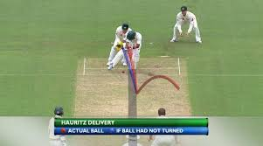
Where and How it can be Used ?
In Live Webcams to telecast cricket
That shows similar kind(Pose estimation and Hand Tracking)
of invention called “Hawkeye Vision” !
And can be given as a web app to find it , for Sports Analyst Team !!
Example:-

Slide 8
Module Descriptions.
Python :
Packages:
OpenCV, Mediapipe , Time
IDE’s : Visiual Studio Code

Slide 9
What is Hand Tracking ?
The process of hand tracking involves utilizing computer vision to identify a hand from an input image and continually monitoring its movement and orientation.
This technology enables the development of a wide range of programs that utilize hand movements and orientation as input.

Slide 10
What is the Problem ?
Normally if a new bowler or a normal bowler who invents a new delivery ,
The analyst team and the whole cricket world , will try to find it , and exploit it , to perform against him !!
For this , we can use Hand- tracking !!!

Slide 11
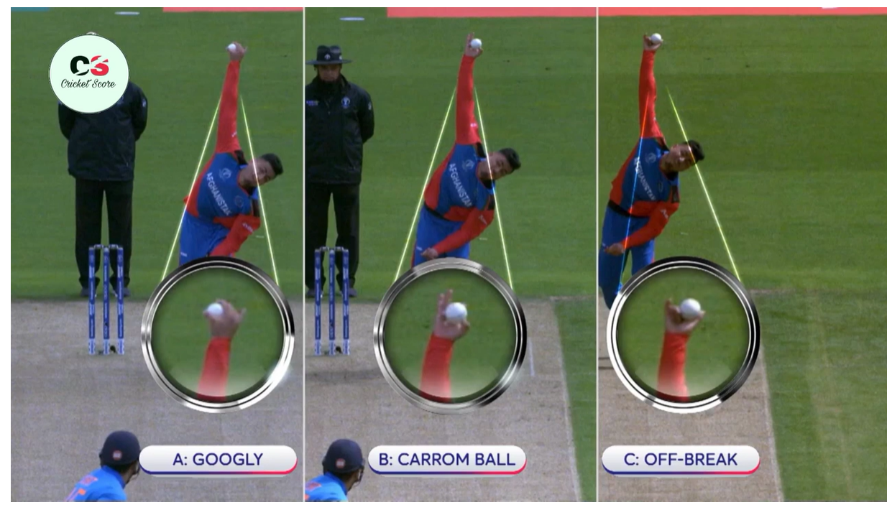
Need for ?
To Identify Mystery deliveries !
And
Analysing
It !!!!

Slide 12
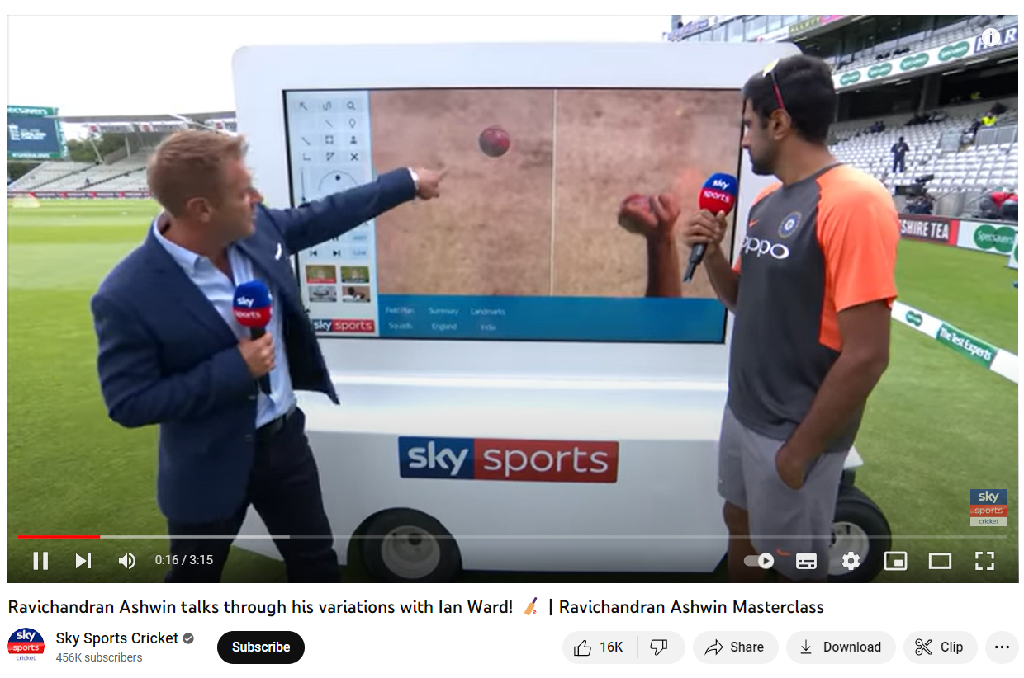
Need for ?
Asking to the bowler , that’s a kind of delivery he is bowling, that too with the wrong Identification of that Delivery !

Slide 13
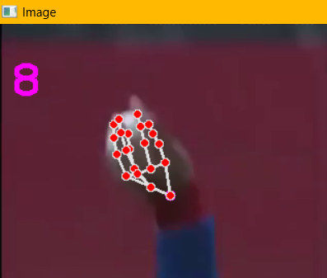
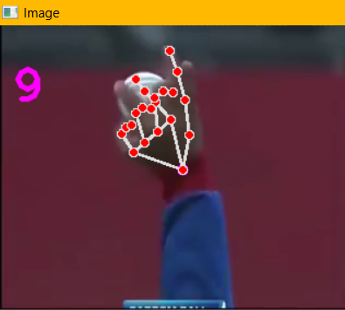
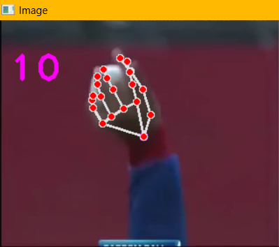
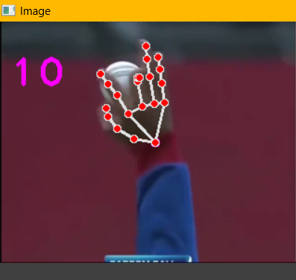
Tracing the actions !

Slide 14
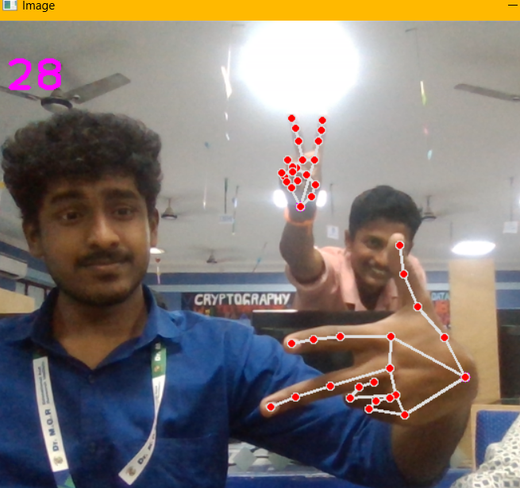
Outputs – Hand Tracking in live !

Slide 15
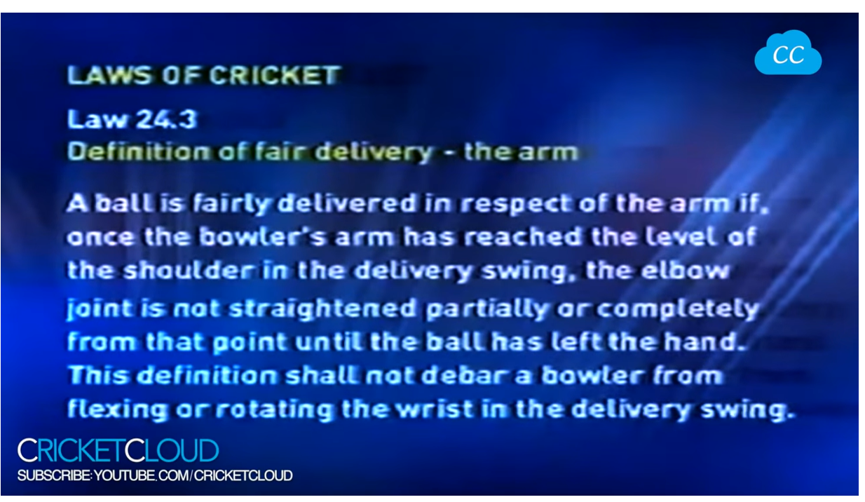
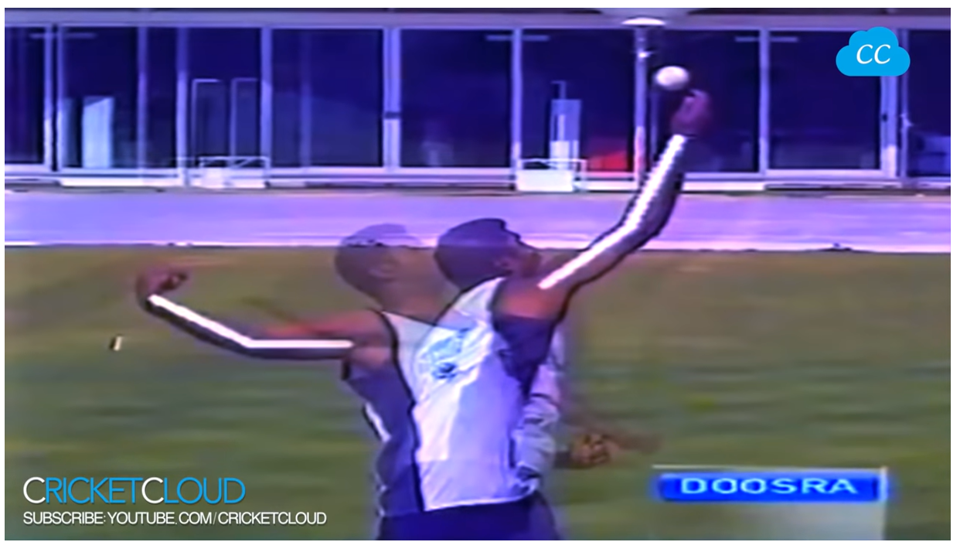
Chucking Action detection
Well , this is not pose Estimation , its just a marking done during the analysis !!!
Instead, We can use Pose Estimation at the same time of match ! , because , in some matches, umpires will give wrong decisions , that can make the team lose also !!!

Slide 16
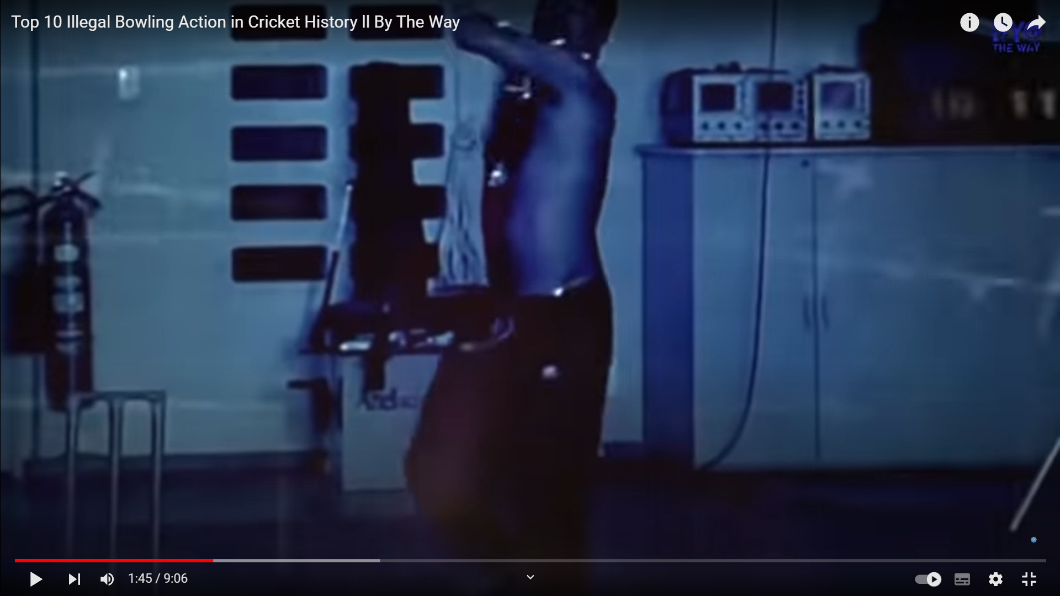
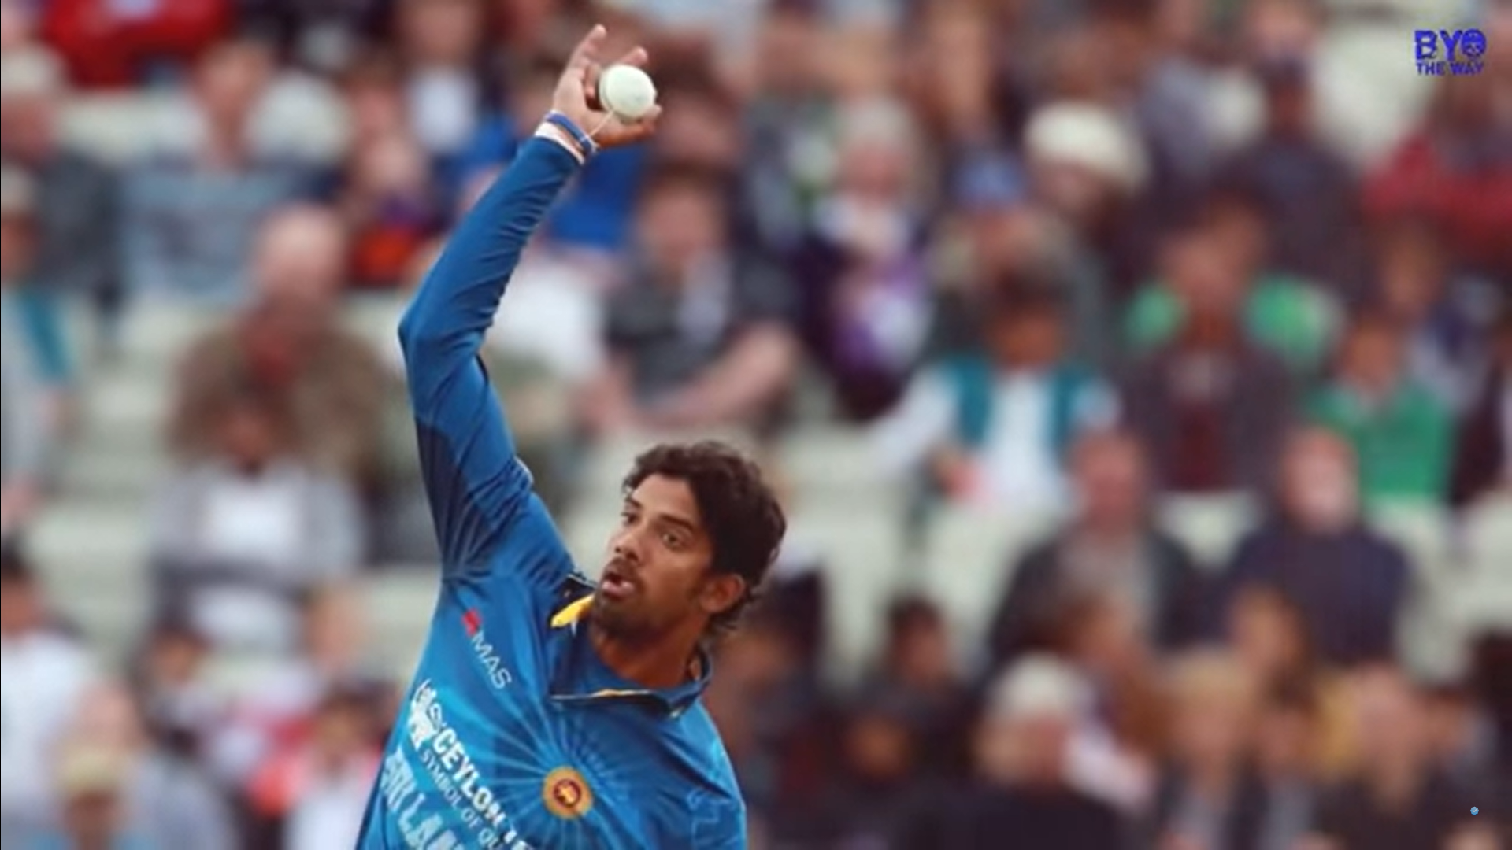
Chucking Action detection
Still They r Using this Mechanism !! , which takes 1 month of Testing , his actions which can spoil the players
Career also !!!!
This is Chucking !!!

Slide 17
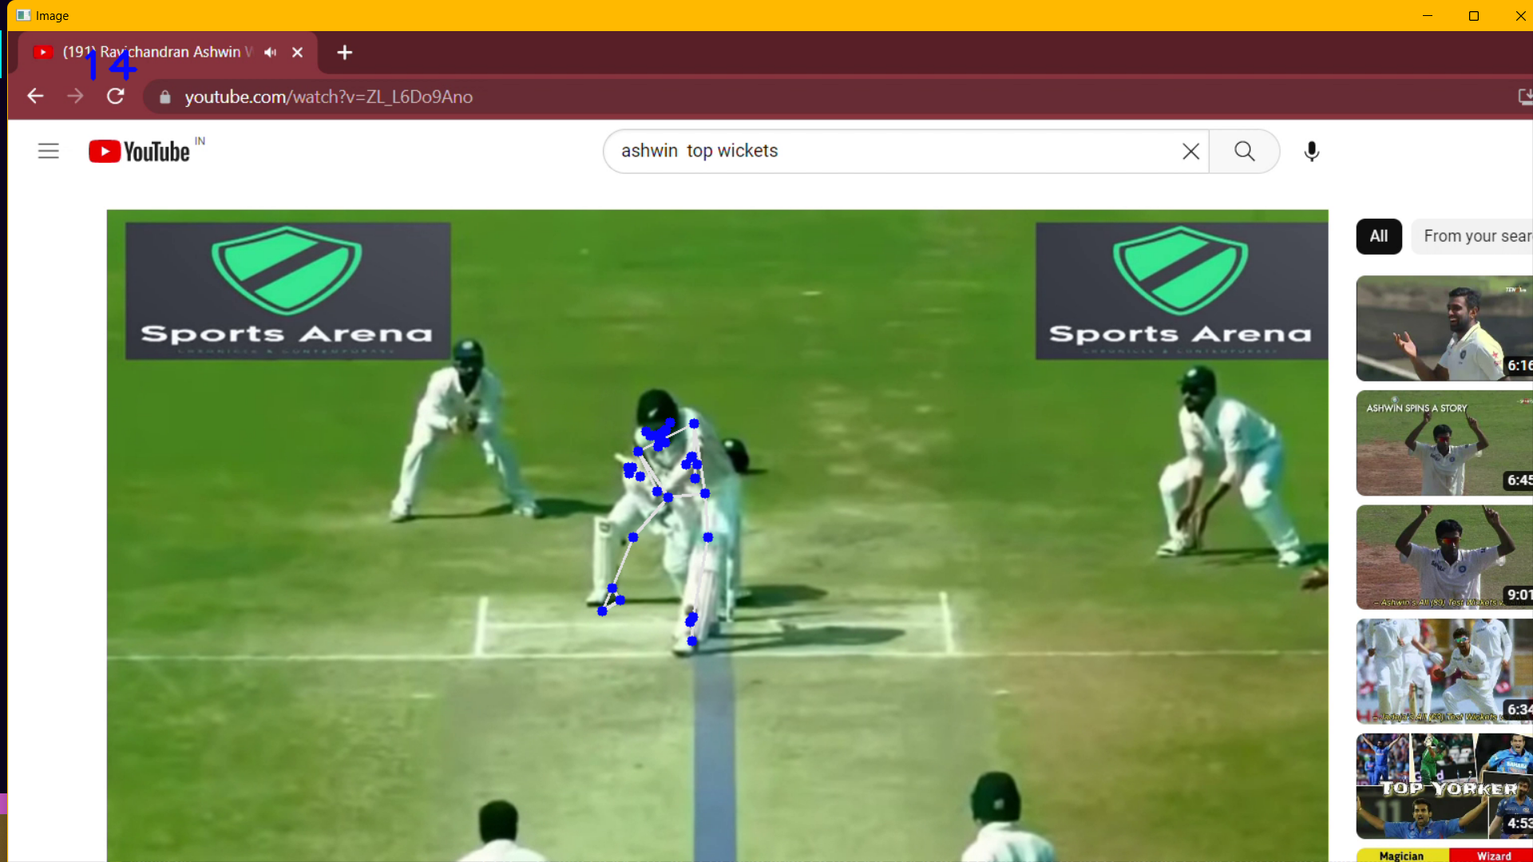
Drs Vision Modification !
Easily we can find It is hitting Stumps or not !!!

Slide 18
What is Pose Estimation ?
The task of pose estimation involves using computer vision techniques to deduce the position and orientation of a person or object in an image or video.
This can also be conceptualized as figuring out the relationship between a camera and the person or object.
To achieve this, various key-points on the object or person are identified, located, and monitored, such as significant features for objects and major joints for humans.
Our machine learning models aim to track these key-points in images and videos.

Slide 19
Categories of Pose Estimation ?
When working with humans, key-points that are tracked in human pose estimation include major joints such as elbows, knees, and wrists.
Objects can be classified as flexible or rigid, with flexible objects requiring pose estimation that takes into account the changing positions of key-points when the object bends or moves. Rigid pose estimation is used for estimating the position of key-points on rigid objects, where the distance between key-points remains the same regardless of orientation.
2D pose estimation involves estimating the X and Y coordinates of key-points in an image or video frame, while 3D pose estimation adds a z-dimension to the prediction to determine the actual spatial positioning of a person or object.
However, 3D pose estimation is a more complex problem due to factors such as lighting conditions and background scenes.
In addition, pose estimation can be classified as single or multi pose estimation, with single pose estimation detecting and tracking one person or object, while multi pose estimation detects and tracks multiple people or objects.

Slide 20
Why Does Pose estimation matter ?
The ability of pose estimation to track objects or people in real-world space with a high level of granularity offers a wide range of potential applications.
This sets it apart from other common computer vision tasks such as object detection, which typically involves identifying objects within an image using bounding boxes.
The potential uses of pose estimation can be seen in its ability to automatically track human movement, which has implications for virtual sports coaches, personal trainers, and workplace safety monitoring.
In addition, pose estimation can be applied in areas such as augmented reality, animation, gaming, and robotics, among others. While this is not an exhaustive list, it highlights some of the primary ways in which pose estimation is shaping the future of technology.

Slide 21
Use Cases and Applications
Human activity and movement
AI-powered sports coaches
Workplace activity monitoring
Crowd counting and tracking
Augmented reality experiences
Animation & Gaming
Robotics

Slide 22
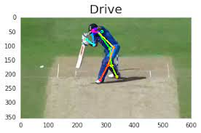
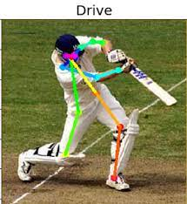
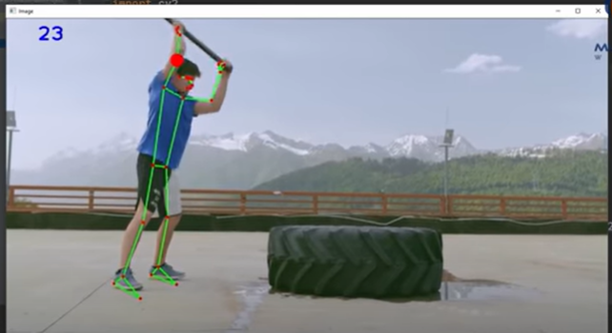
Samples in 2D

Slide 23
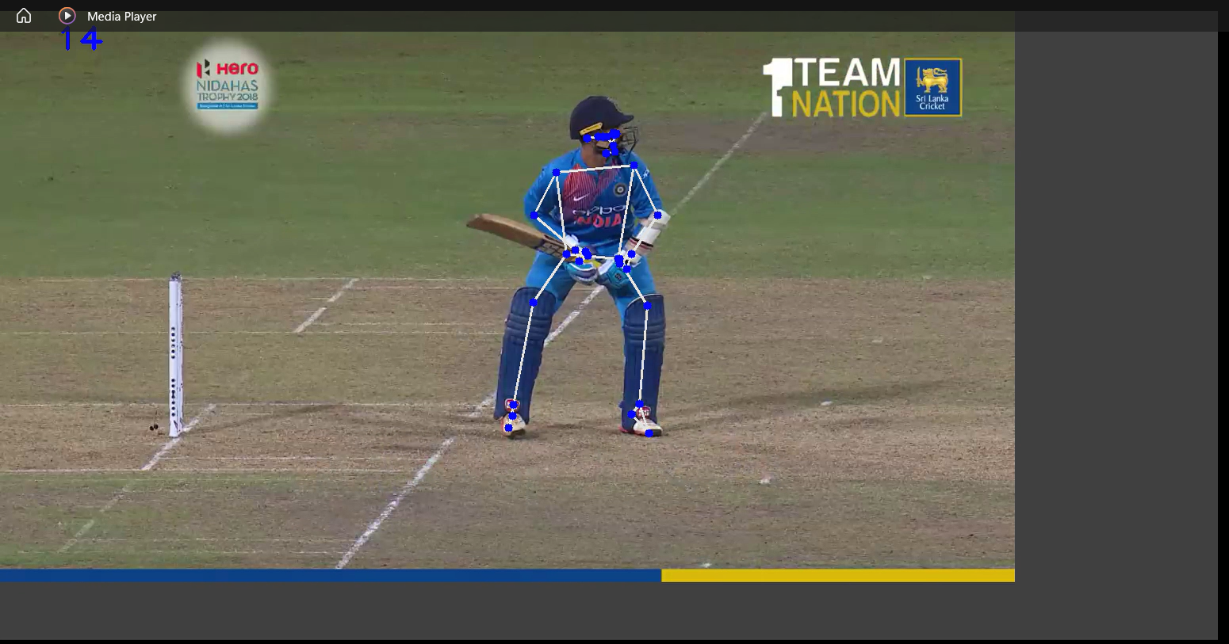
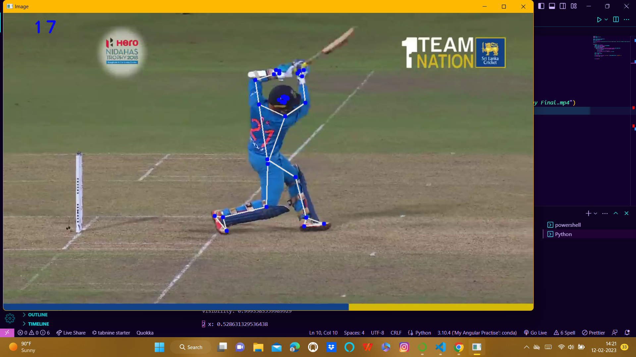
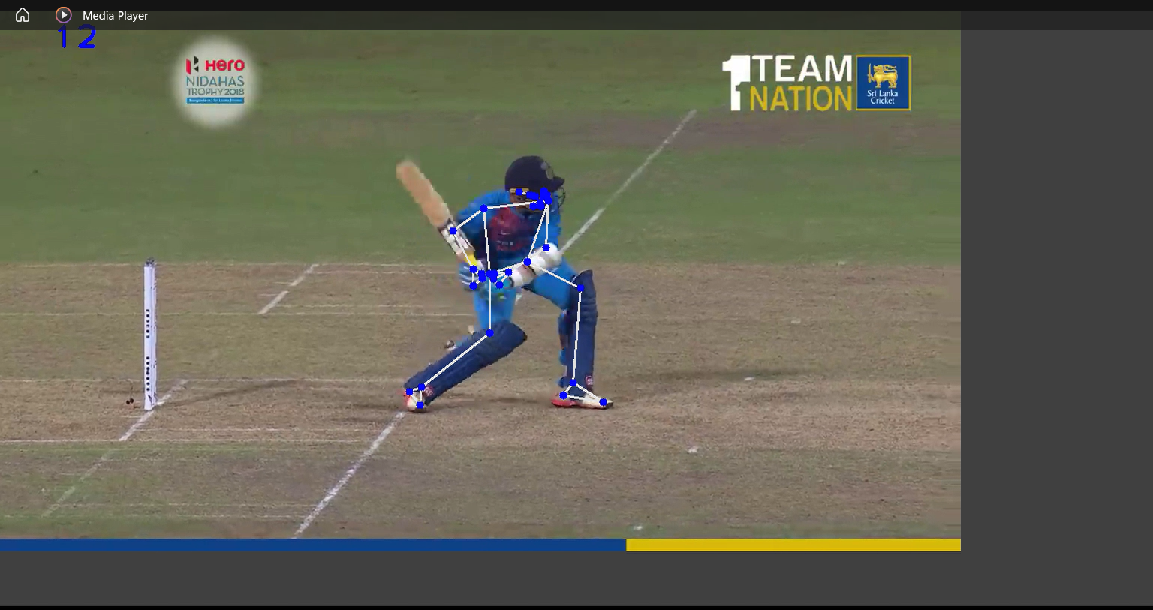
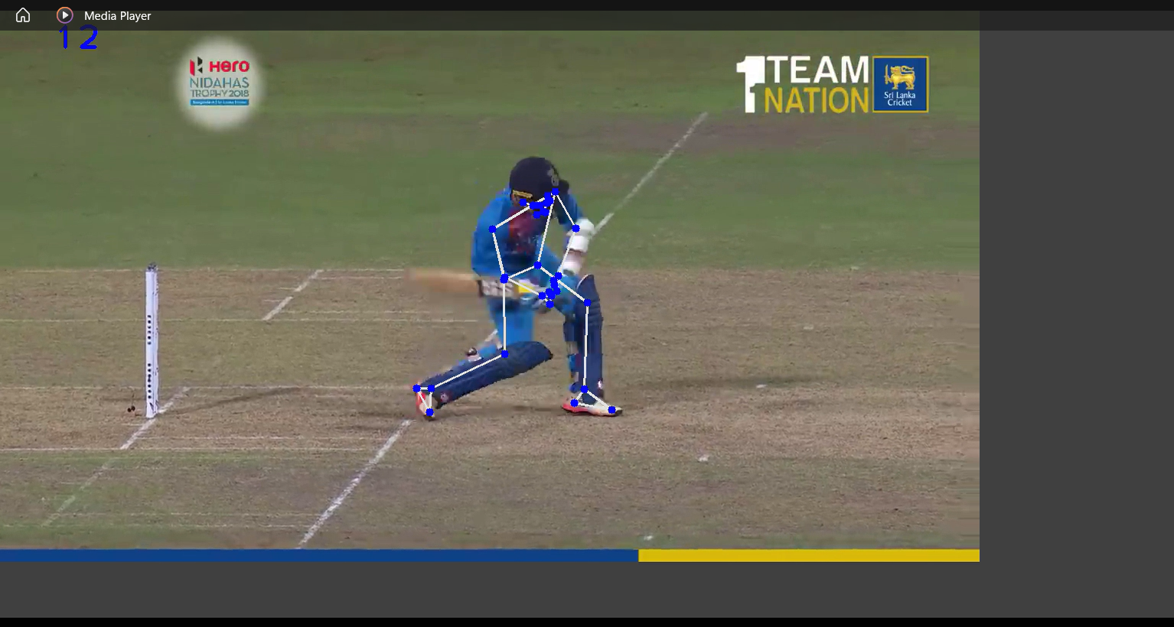
Outputs in 3D - Pose Estimation

Slide 24
Highlights And Uses :
Pose Estimation
Hand Tracking
DRS Vision Modification
Chucking Identification
Under-Arm Action Detection

Slide 25
Conclusions.
Outlook and Future Trends :
Pose estimation for objects is a major trend in computer vision. Pose estimation and Hand Tracking allows gaining a more detailed understanding of objects compared to two-dimensional bounding boxes. Until now, pose estimation is still computationally very intensive and requires expensive AI hardware (often multiple NVIDIA GPUs) that is not practical for real-world use.
Edge AI technology :
New technologies and methods make it possible to decrease the size of AI models, making pose estimation algorithms less “heavy” and much more efficient. This is the basis for the real-world implementation of human pose detection. As a result, it becomes possible to deploy pose estimation algorithms to edge devices and perform on-device machine learning (Edge AI). Edge Inference makes the technology scalable, more robust for mission-critical applications (offline capability), and private (no visuals need to be sent to the cloud). An example of a lightweight pose estimation model for Edge ML is Lightweight Open Pose.

Slide 26
Thank You !

